Slide 1
Unit 6
Distributed Databases

Slide 2
Distributed Database Concepts
A transaction can be executed by multiple networked computers in a unified manner.
A distributed database (DDB) processes Unit of execution (a transaction) in a distributed manner. DDB can be defined as
  A distributed database (DDB) is a collection of multiple logically related database distributed over a computer network, and a distributed database management system as a software system that manages a distributed database while making the distribution transparent to the user.

Slide 3
Differences between DDB and Multiprocessor Systems
shared storage (primary memory or disk).
For a database to be called distributed,
the following minimum conditions should be satisfied:
■ Connection of database nodes over a computer network. There are multiple computers, called sites or nodes. These sites must be connected by an underlying communication network to transmit data and commands among sites, as shown later in Figure (c).
■ Logical interrelation of the connected databases. It is essential that the information in the databases be logically related.
■ Absence of homogeneity constraint among connected nodes. It is not necessary that all nodes be identical in terms of data, hardware, and software.

Slide 4
Reasons for
Distributed Database
Business unit autonomy and distribution
Data sharing
Data communication costs
Data communication reliability and costs
Multiple application vendors
Database recovery
Transaction and analytic processing

Slide 5
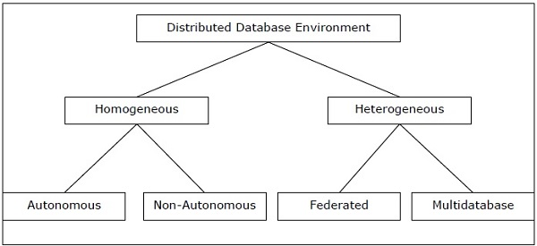
Types of DDBS

Slide 6
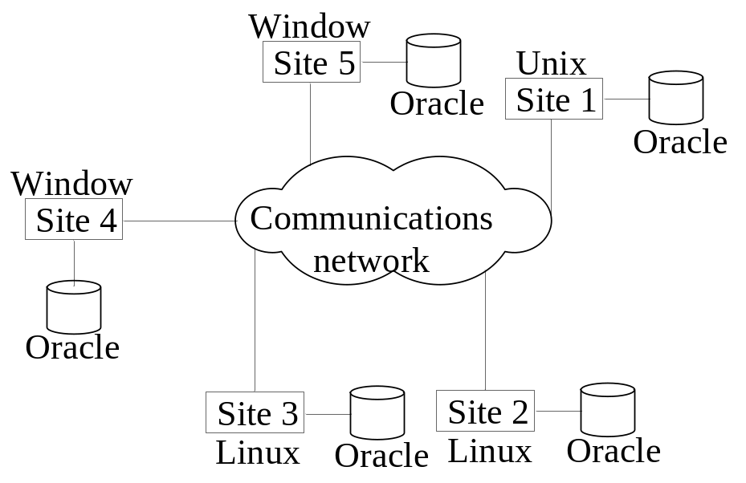
Types of Distributed Database Systems
Homogeneous
  All sites of the database system have identical setup, i.e., same database system software.
  For example, all sites run Oracle or DB2, or Sybase or some other database system.
  The underlying operating system may be different.
  The underlying operating systems can be a mixture of Linux, Window, Unix, etc.

Slide 7
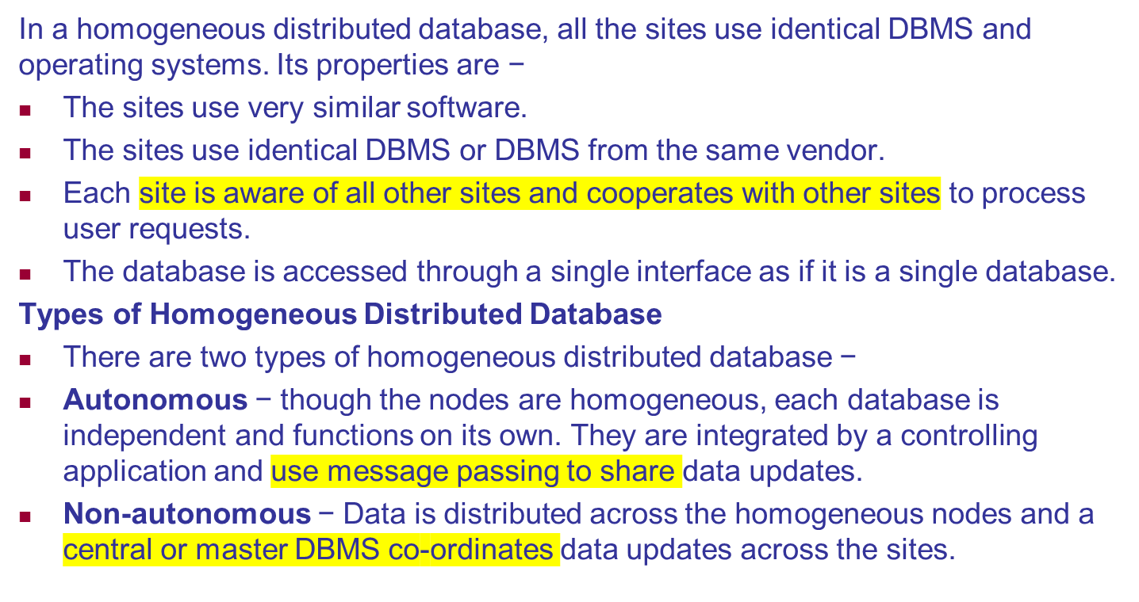
Homogeneous Distributed Databases

Slide 8
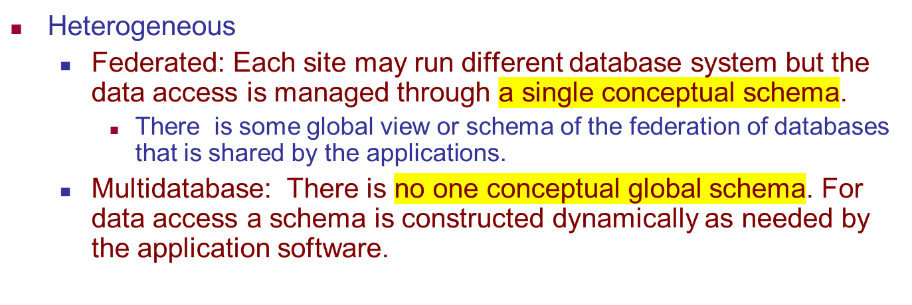
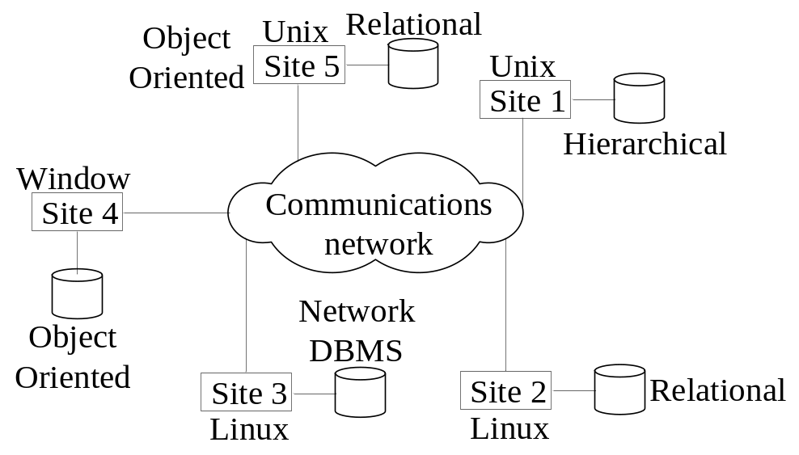
Types of Distributed Database Systems

Slide 9
Heterogeneous Distributed Databases
In a heterogeneous distributed database, different sites have different operating systems, DBMS products and data models. Its properties are −
Different sites use dissimilar schemas and software.
The system may be composed of a variety of DBMSs like relational, network, hierarchical or object oriented.
Query processing is complex due to dissimilar schemas.
Transaction processing is complex due to dissimilar software.
A site may not be aware of other sites and so there is limited co-operation in processing user requests.
Notes:
Since the constituent database systems remain autonomous, a federated database system is a contrastable alternative to the (sometimes daunting) task of merging several disparate databases. A federated database, or virtual database, is a composite of all constituent databases in a federated database system.

Slide 10
Types of Heterogeneous Distributed Databases
Federated − The heterogeneous database systems are independent in nature and integrated together so that they function as a single database system.
Un-federated − The database systems employ a central coordinating module through which the databases are accessed.
Semantic Heterogeneity. Semantic heterogeneity occurs when there are differences in the meaning, interpretation, Transaction and policy constraints, Derivation of summaries and intended use of the same or related data. Semantic heterogeneity among component database systems (DBSs) creates the biggest hurdle in designing global schemas of heterogeneous databases.

Slide 11
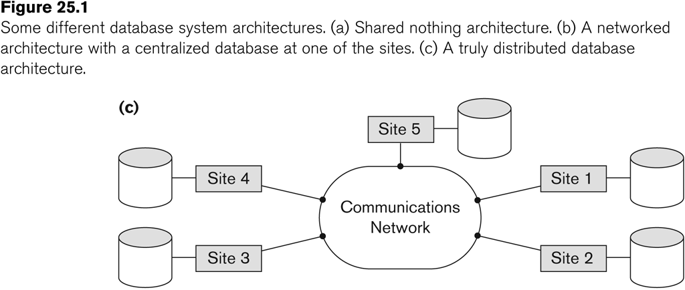
Distributed Database System
Advantages
  Management of distributed data with different levels of transparency:
    This refers to the physical placement of data or location transperancy(files, relations, etc.) which is not known to the user (distribution transparency).

Slide 12
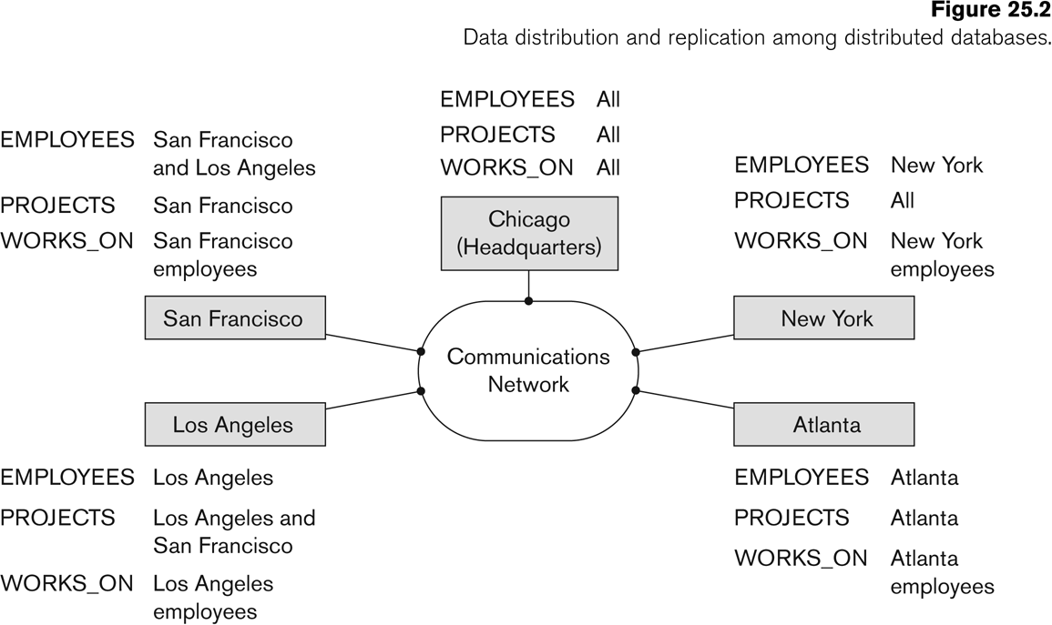
Distributed Database System
Advantages (transparency, contd.)
  The EMPLOYEE, PROJECT, and WORKS_ON tables may be fragmented horizontally and stored with possible replication as shown below.

Slide 13
Distributed Database System
Advantages (transparency, contd.)
  Distribution and Network transparency:
    Users do not have to worry about operational details of the network.
      There is Location transparency, which refers to freedom of issuing command from any location without affecting its working.
      Then there is Naming transparency, which allows access to any names object (files, relations, etc.) from any location.

Slide 14
Distributed Database System
Advantages (transparency, contd.)
  Replication transparency:
    It allows to store copies of a data at multiple sites.
    This is done to minimize access time to the required data.
  Fragmentation transparency:
    Allows to fragment a relation horizontally (create a subset of tuples of a relation) or vertically (create a subset of columns of a relation).

Slide 15
Distributed Database System
Other Advantages
  Increased reliability and availability:
    Reliability refers to system live time, that is, system is running efficiently most of the time. Availability is the probability that the system is continuously available (usable or accessible) during a time interval.
    A distributed database system has multiple nodes (computers) and if one fails then others are available to do the job.

Slide 16
Distributed Database System
Other Advantages (contd.)
  Improved performance:
    A distributed DBMS fragments the database to keep data closer to where it is needed most.
    This reduces data management (access and modification) time significantly.
  Easier expansion (scalability):
    Allows new nodes (computers) to be added anytime without chaining the entire configuration.

Slide 17
Data Fragmentation, Replication and Allocation
Data Fragmentation
  Split a relation into logically related and correct parts. A relation can be fragmented in two ways:
    Horizontal Fragmentation
    Vertical Fragmentation

Slide 18
Data Fragmentation, Replication and Allocation
Horizontal fragmentation
  It is a horizontal subset of a relation which contain those of tuples which satisfy selection conditions.
  Consider the Employee relation with selection condition (DNO = 5). All tuples satisfy this condition will create a subset which will be a horizontal fragment of Employee relation.
  A selection condition may be composed of several conditions connected by AND or OR.
  Derived horizontal fragmentation: It is the partitioning of a primary relation to other secondary relations which are related with Foreign keys.

Slide 19
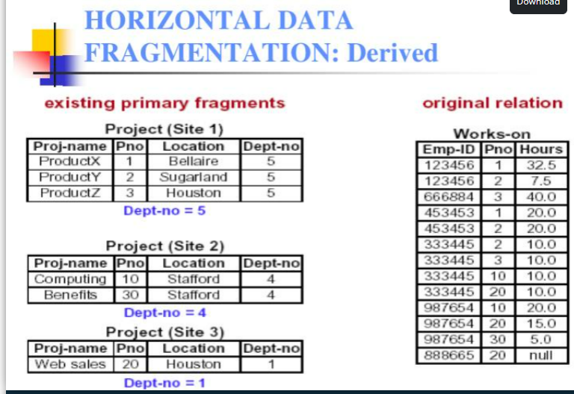


Slide 20
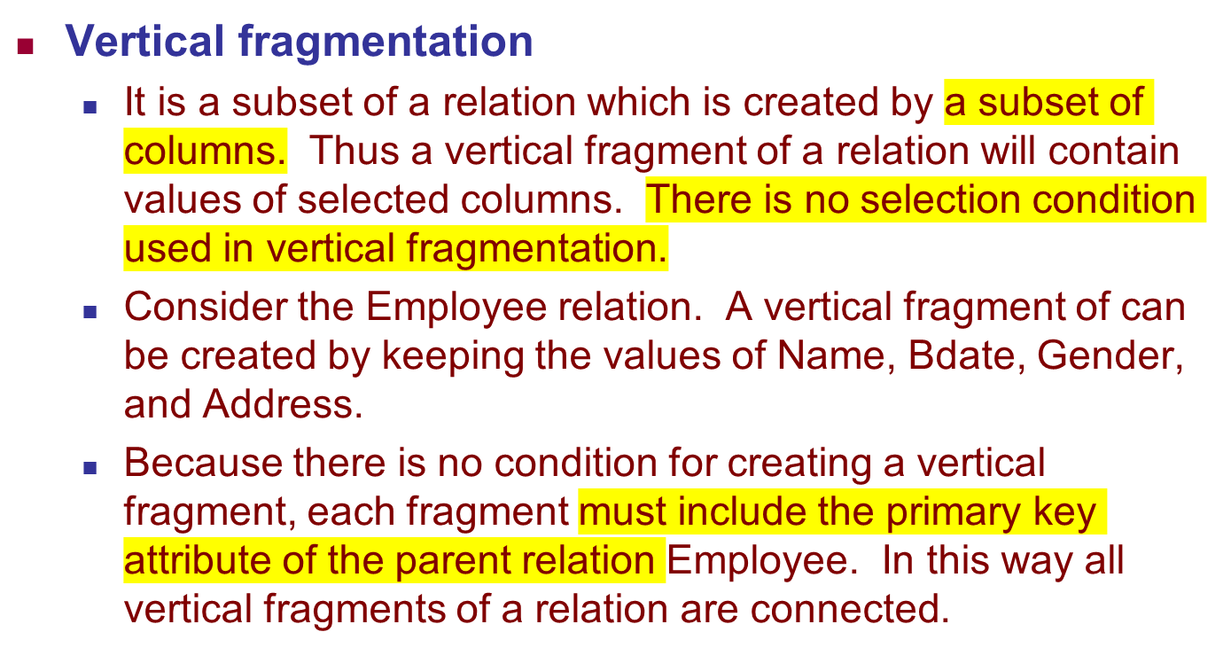
Data Fragmentation, Replication and Allocation

Slide 21
Data Fragmentation, Replication and Allocation
Representation
  Horizontal fragmentation (select operation)
    Each horizontal fragment on a relation can be specified by a σ_{Ci} (R) operation in the relational algebra.
    Complete horizontal fragmentation
    A set of horizontal fragments whose conditions C1, C2, …, Cn include all the tuples in R- that is, every tuple in R satisfies (C1 OR C2 OR … OR Cn).
    Disjoint complete horizontal fragmentation: No tuple in R satisfies (Ci AND Cj) where i ≠ j.
    To reconstruct R from horizontal fragments a UNION is applied.

Slide 22
Select Operation – Example
Relation r
A
B
C
D
α
α
β
β
α
β
β
β
1
5
12
23
7
7
3
10
σ_{A=B ^ D > 5} (r)
A
B
C
D
α
β
α
β
1
23
7
10

Slide 23
Data Fragmentation, Replication and Allocation
Representation
  Vertical fragmentation
    A vertical fragment on a relation can be specified by a Π_{Li}(R) operation in the relational algebra.
    Complete vertical fragmentation
    A set of vertical fragments whose projection lists L1, L2, …, Ln include all the attributes in R but share only the primary key of R. In this case the projection lists satisfy the following two conditions:
    L1 ∪ L2 ∪ ... ∪ Ln = ATTRS (R)
    Li ∩ Lj = PK(R) for any i j, where ATTRS (R) is the set of attributes of R and PK(R) is the primary key of R.
    To reconstruct R from complete vertical fragments a JOIN is applied.

Slide 24
Project Operation – Example
A
B
C
Relation r:
α
α
β
β
10
20
30
40
1
1
1
2
A
C
A
C
∏_{A,C} (r)
α
α
β
β
1
1
1
2
α
β
β
1
1
2
=
fragmentation
Example

Slide 25
Data Fragmentation, Replication and Allocation
Representation
  Mixed (Hybrid) fragmentation
    A combination of Vertical fragmentation and Horizontal fragmentation.
    This is achieved by SELECT-PROJECT operations which is represented by Π_{Li}(σ_{Ci} (R)).
If C = TRUE (that is, all tuples are selected) and L ≠ ATTRS(R), we get a vertical fragment,
and if C ≠ TRUE and L = ATTRS(R), we get a horizontal fragment. Finally, if
C ≠ TRUE and L ≠ ATTRS(R), we get a mixed fragment.

Slide 26
Data Fragmentation, Replication and Allocation
Fragmentation schema
  A definition of a set of fragments (horizontal or vertical or horizontal and vertical) that includes all attributes and tuples in the database that satisfies the condition that the whole database can be reconstructed from the fragments by applying some sequence of UNION (or OUTER JOIN) and UNION operations.
Allocation schema
  It describes the distribution of fragments to sites of distributed databases. It can be fully or partially replicated or can be partitioned.
Global Schema : Specification of global relations

Slide 27
Data Fragmentation, Replication and Allocation
Data Replication
  Database is replicated to all sites.
  Full replication the entire database is replicated
  No replication
  partial replication some selected part is replicated to some of the sites.
  Data replication is achieved through a replication schema.
Several factors influence the decision to use data replication:
Database size.: band width, transmission cost etc.
Usage frequency: to decide the frequency of data updation
Costs, including those for performance, software overhead, and management associated with synchronizing transactions and their components vs. fault- tolerance benefits that are associated with replicated data.
Data replication information is stored in the distributed data catalog (DDC), Whose contents are used by the TP to decide which copy of a database fragment to access

Slide 28
Data Distribution (Data Allocation)
  The selected portion of the database is distributed to the database sites.
  Data allocation describes the process of deciding where to locate data. Data allocation strategies are as follows:
  With centralized data allocation, the entire database is stored at one site.
  With partitioned data allocation , the database is divided into two or more
  disjointed parts (fragments) and stored at two or more sites.
  With replicated data allocation , copies of one or more database fragments are
  stored at several sites.

Slide 29
Types of Distributed Database Systems
Federated Database Management Systems Issues
  Differences in data models:
    Relational, Objected oriented, hierarchical, network, etc.
  Differences in constraints:
    Each site may have their own data accessing and processing constraints.
  Differences in query language:
    Some site may use SQL, some may use SQL-89, some may use SQL-92, and so on.

Slide 30
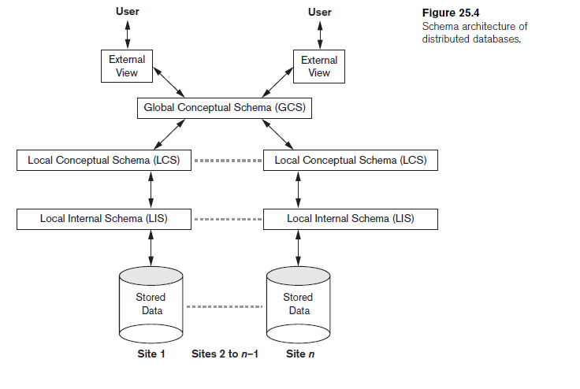
Architecture of Distributed Databases

Slide 31
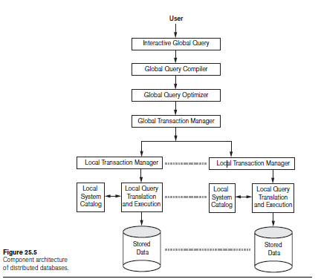
Architecture of Distributed Databases

Slide 32
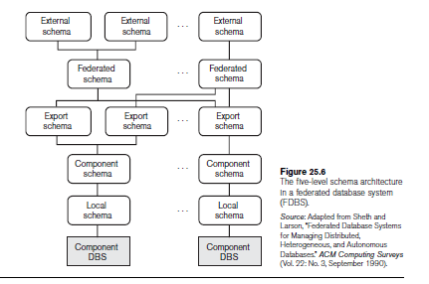
Architecture of Distributed Databases

Slide 33
Architecture of Distributed Databases
Communication Autonomy
Execution Autonomy
Association Autonomy

Slide 34
Concurrency Control and Recovery
Distributed Databases encounter a number of concurrency control and recovery problems which are not present in centralized databases. Some of them are listed below.
  Dealing with multiple copies of data items
  Failure of individual sites
  Communication link failure
  Distributed commit
  Distributed deadlock

Slide 35
Concurrency Control and Recovery
Details
  Dealing with multiple copies of data items:
    The concurrency control must maintain global consistency. Likewise the recovery mechanism must recover all copies and maintain consistency after recovery.
  Failure of individual sites:
    Database availability must not be affected due to the failure of one or two sites and the recovery scheme must recover them before they are available for use.

Slide 36
Concurrency Control and Recovery
Details (contd.)
  Communication link failure:
    This failure may create network partition which would affect database availability even though all database sites may be running.
  Distributed commit:
    A transaction may be fragmented and they may be executed by a number of sites. This require a two or three-phase commit approach for transaction commit.
  Distributed deadlock:
    Since transactions are processed at multiple sites, two or more sites may get involved in deadlock. This must be resolved in a distributed manner.

Slide 37
Concurrency control
Based on distinguished copy of data item.
Distinguished copy holds lock and unlock on that data item.

Slide 38
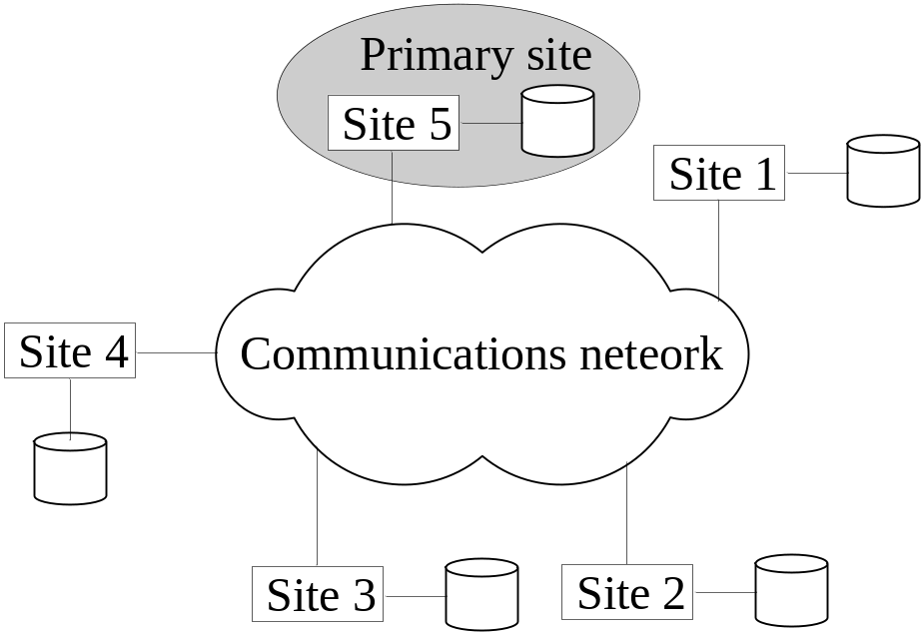
Concurrency Control and Recovery
Distributed Concurrency control based on a distributed copy of a data item
  1. Primary site technique: A single site is designated as a primary site which serves as a coordinator for transaction management.

Slide 39
Concurrency Control and Recovery
Transaction management:
  Concurrency control and commit are managed by this site.
  In two phase locking, this site manages locking and releasing data items. If all transactions follow two-phase policy at all sites, then serializability is guaranteed.

Slide 40
Concurrency Control and Recovery
Transaction Management
  Advantages:
    An extension to the centralized two phase locking so implementation and management is simple.
    Data items are locked only at one site but they can be accessed at any site.
once a transaction obtains a Read_lock on a data item from the primary site, it can access any copy of that data item. However, once a transaction obtains a Write_lock and updates a data item, the DDBMS is responsible for updating all copies of the data item before releasing the lock.
  Disadvantages:
    All transaction management activities go to primary site which is likely to overload the site.
    If the primary site fails, the entire system is inaccessible.
  To aid recovery a backup site is designated which behaves as a shadow of primary site. In case of primary site failure, backup site can act as primary site.

Slide 41
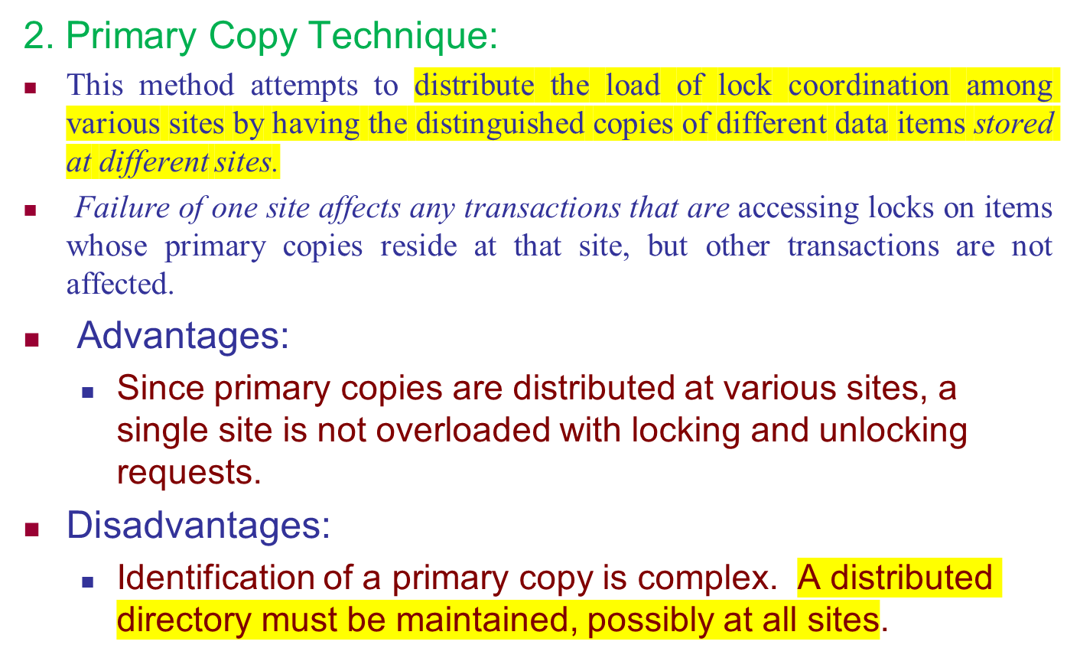
Concurrency Control and Recovery

Slide 42
Concurrency Control and Recovery
Recovery from a coordinator failure
  In both approaches a coordinator site or copy may become unavailable. This will require the selection of a new coordinator.
Primary site approach with no backup site:
  Aborts and restarts all active transactions at all sites. Elects a new coordinator and initiates transaction processing.
Primary site approach with backup site:
  All locking information is maintained at both the primary and the backup sites. In case of primary site failure, the backup site takes over as the primary site, and a new backup site is chosen.
Primary and backup sites fail or no backup site:
  Use election process to select a new coordinator site.

Slide 43
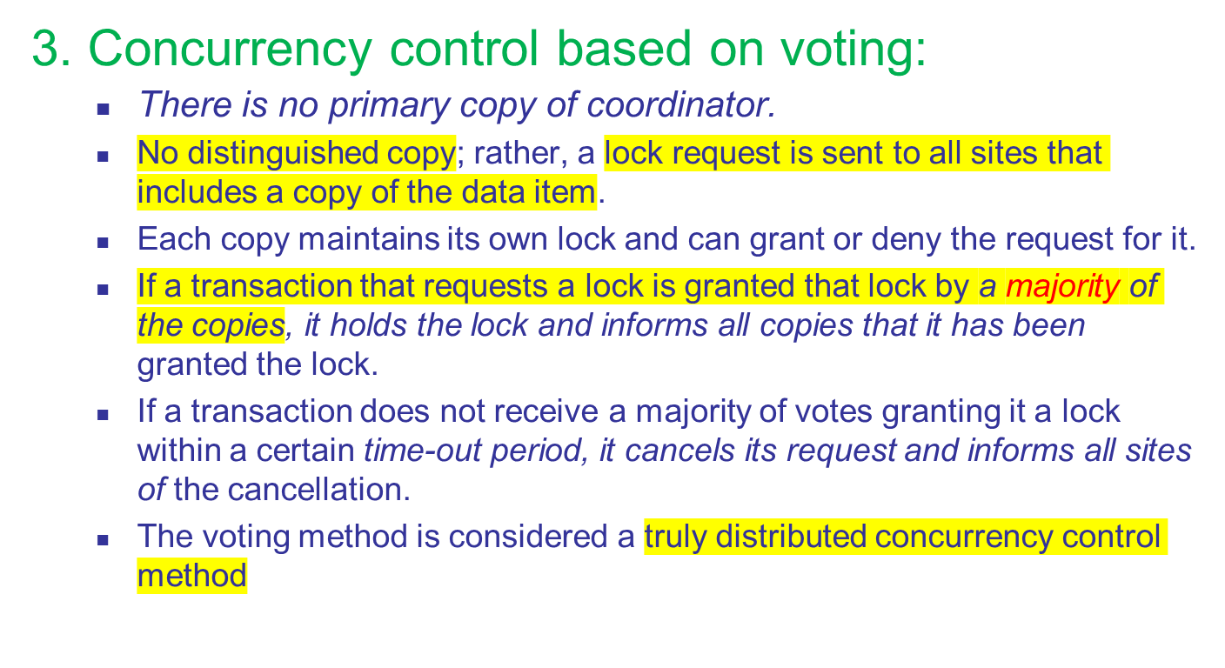
Concurrency Control and Recovery

Slide 44
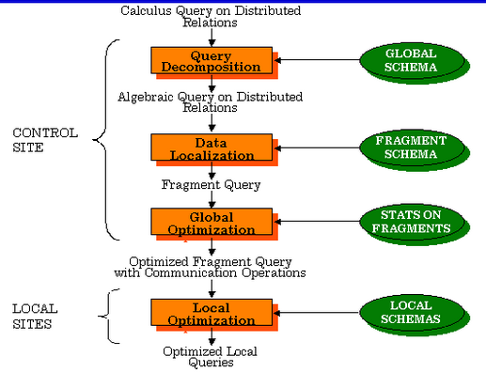
Query Processing in Distributed Databases
1.Query Mapping. The input query on distributed data is specified formally using a query language. It is then translated into an algebraic query on global relations. It is first normalized, analyzed for semantic errors , simplified, and finally restructured into an algebraic query.
2. Localization.
3. Global Query Optimization
4. Local Query Optimization

Slide 45
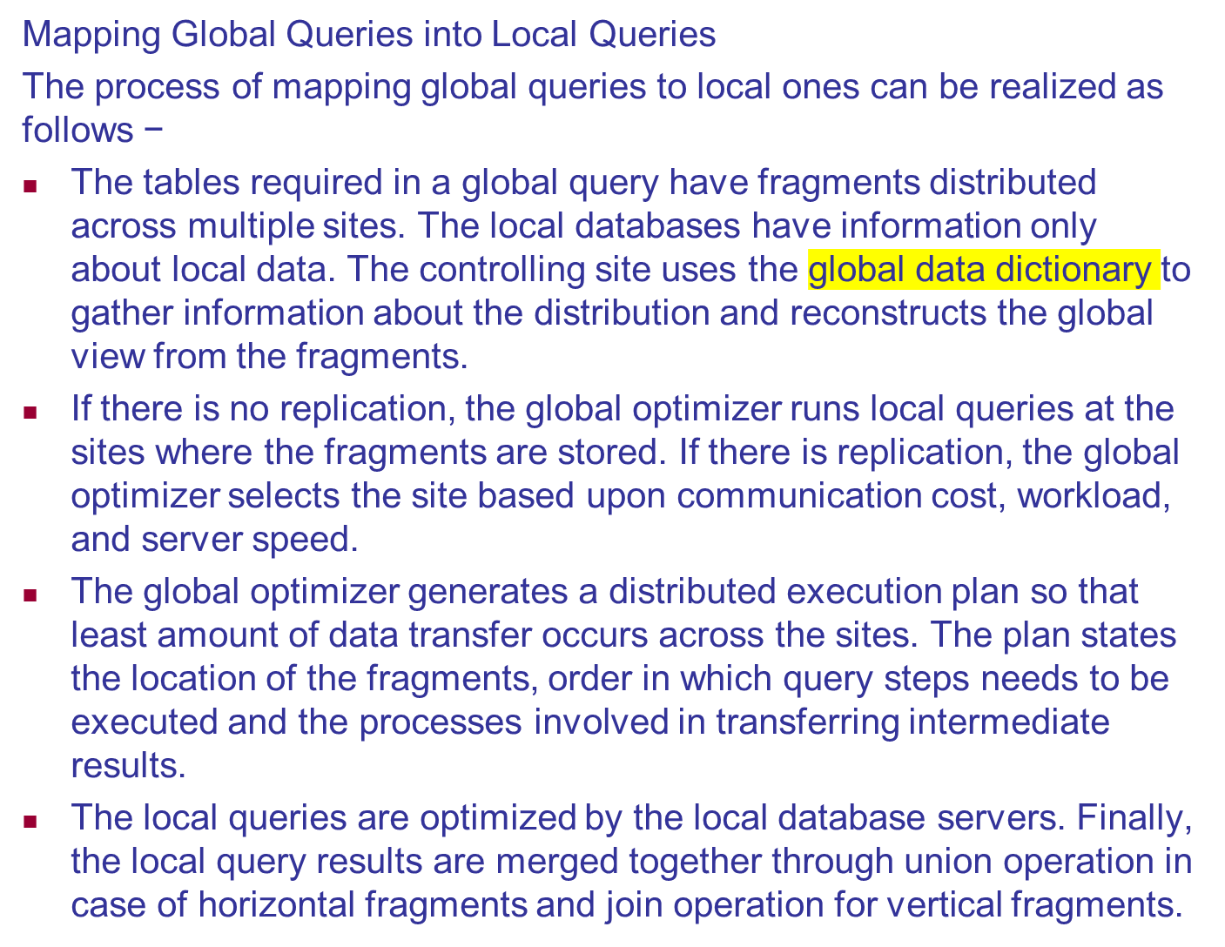

Slide 46
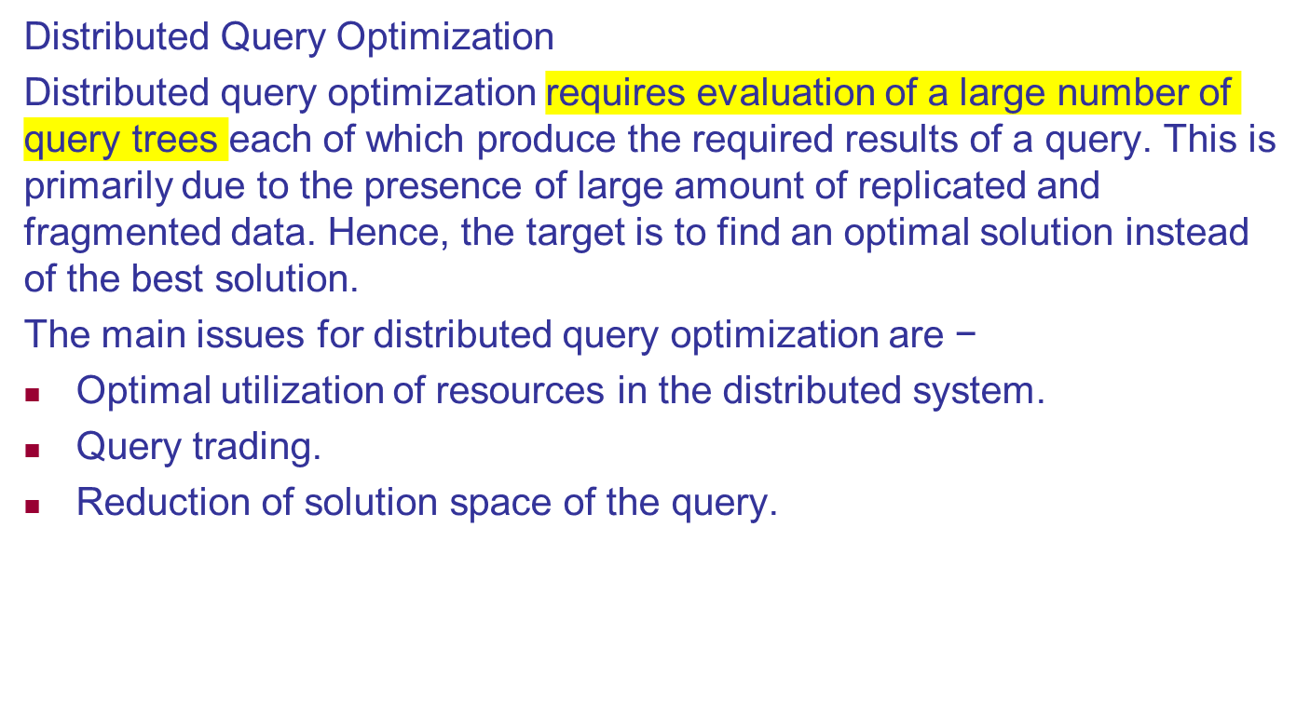

Slide 47
Optimal Utilization of Resources in the Distributed System
A distributed system has a number of database servers in the various sites to perform the operations pertaining to a query. Following are the approaches for optimal resource utilization −
Operation Shipping − In operation shipping, the operation is run at the site where the data is stored and not at the client site. The results are then transferred to the client site. This is appropriate for operations where the operands are available at the same site. Example: Select and Project operations.
Data Shipping − In data shipping, the data fragments are transferred to the database server, where the operations are executed. This is used in operations where the operands are distributed at different sites. This is also appropriate in systems where the communication costs are low, and local processors are much slower than the client server.
Hybrid Shipping − This is a combination of data and operation shipping. Here, data fragments are transferred to the high-speed processors, where the operation runs. The results are then sent to the client site.

Slide 48
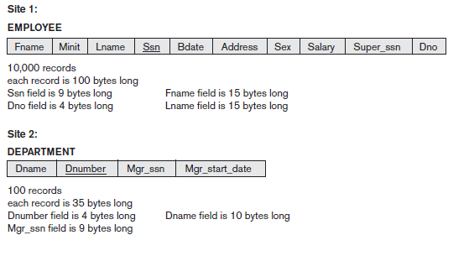
Distributed query processing:example

Slide 49

Data Transfer Costs of Distributed Query Processing:
Cost of transferring data (files and results) over the network.
    This cost is usually high so some optimization is necessary.
    Example relations: Employee at site 1 and Department at Site 2
      Employee at site 1. 10,000 rows. Row size = 100 bytes. Table size = 10⁶ bytes.
      Department at Site 2. 100 rows. Row size = 35 bytes. Table size = 3,500 bytes.
    Q: For each employee, retrieve employee name and department name Where the employee works.
    Q: Π_{Fname,Lname,Dname} (Employee _{Dno = Dnumber} Department)
Fname | Minit | Lname | SSN | Bdate | Address | Sex | Salary | Superssn | Dno
Dname | Dnumber | Mgrssn | Mgrstartdate

Slide 50
Query Processing in Distributed Databases
Result
  The result of this query will have 10,000 tuples, assuming that every employee is related to a department.
  Suppose each result tuple is 40 bytes long.
  The query is submitted at site 3 and the result is sent to this site.
  Problem: Employee and Department relations are not present at site 3.

Slide 51
Query Processing in Distributed Databases
Strategies:
  Transfer Employee and Department to site 3.
    Total transfer bytes = 1,000,000 + 3500 = 1,003,500 bytes.
  Transfer Employee to site 2, execute join at site 2 and send the result to site 3.
    Total transfer size = 400,000 + 1,000,000 = 1,400,000 bytes.
    Query result size = 40 * 10,000 = 400,000 bytes.
  Transfer Department relation to site 1, execute the join at site 1, and send the result to site 3.
    Total bytes transferred = 400,000 + 3500 = 403,500 bytes.
Optimization criteria: minimizing data transfer.

Slide 52
Query Processing in Distributed Databases
Strategies:
  Transfer Employee and Department to site 3.
    Total transfer bytes = 1,000,000 + 3500 = 1,003,500 bytes.
  Transfer Employee to site 2, execute join at site 2 and send the result to site 3.
    Query result size = 40 * 10,000 = 400,000 bytes. Total transfer size = 400,000 + 1,000,000 = 1,400,000 bytes.
  Transfer Department relation to site 1, execute the join at site 1, and send the result to site 3.
    Total bytes transferred = 400,000 + 3500 = 403,500 bytes.
Optimization criteria: minimizing data transfer.
  Preferred approach: strategy 3.

Slide 53
Query Processing in Distributed Databases
Consider the query
  Q’: For each department, retrieve the department name and the name of the department manager
Relational Algebra expression:
  Π_{Fname,Lname,Dname} (Employee _{Mgrssn = SSN} Department)

Slide 54
Query Processing in Distributed Databases
The result of this query will have 100 tuples, assuming that every department has a manager, the execution strategies are:
  Transfer Employee and Department to the result site and perform the join at site 3.
    Total bytes transferred = 1,000,000 + 3500 = 1,003,500 bytes.
  Transfer Employee to site 2, execute join at site 2 and send the result to site 3. Query result size = 40 * 100 = 4000 bytes.
    Total transfer size = 4000 + 1,000,000 = 1,004,000 bytes.
  Transfer Department relation to site 1, execute join at site 1 and send the result to site 3.
    Total transfer size = 4000 + 3500 = 7500 bytes.

Slide 55
Query Processing in Distributed Databases
The result of this query will have 100 tuples, assuming that every department has a manager, the execution strategies are:
  Transfer Employee and Department to the result site and perform the join at site 3.
    Total bytes transferred = 1,000,000 + 3500 = 1,003,500 bytes.
  Transfer Employee to site 2, execute join at site 2 and send the result to site 3. Query result size = 40 * 100 = 4000 bytes.
    Total transfer size = 4000 + 1,000,000 = 1,004,000 bytes.
  Transfer Department relation to site 1, execute join at site 1 and send the result to site 3.
    Total transfer size = 4000 + 3500 = 7500 bytes.
Preferred strategy: Choose strategy 3.

Slide 56
Query Processing in Distributed Databases
Now suppose the result site is 2. Possible strategies :
  Transfer Employee relation to site 2, execute the query and present the result to the user at site 2.
    Total transfer size = 1,000,000 bytes for both queries Q and Q’.
  Transfer Department relation to site 1, execute join at site 1 and send the result back to site 2.
    Total transfer size for Q = 400,000 + 3500 = 403,500 bytes
    and for
    Q’ = 4000 + 3500 = 7500 bytes.

Slide 57
Query Processing in Distributed Databases
Semijoin:
  Objective is to reduce the number of tuples and attributes in a relation before transferring it to another site.
Example execution of Q or Q’:
  Project the join attributes of Department at site 2, and transfer them to site 1. For Q, 4 * 100 = 400 bytes are transferred and for Q’, 9 * 100 = 900 bytes are transferred.
  Join the transferred file with the Employee relation at site 1, and transfer the required attributes from the resulting file to site 2. For Q, 34 * 10,000 = 340,000 bytes are transferred and for Q’, 39 * 100 = 3900 bytes are transferred.
  Execute the query by joining the transferred file with Department and present the result to the user at site 2.

Slide 58
Query Processing in Distributed Databases
A semijoin operation
R semijoin_{A=B} S, where A and B are domain-compatible attributes of R and S, respectively , produces the same result as the relational algebra expression π_{R}(Rx _{A=B} S). In a distributed environment where R and S reside at different sites, the semijoin is typically implemented by first transferring F = π_{B}(S) to the site where R resides and
then joining F with R, thus leading to the strategy discussed here.Notice that the semijoin operation is not commutative;

Slide 59
Query and Update Decomposition

Slide 60
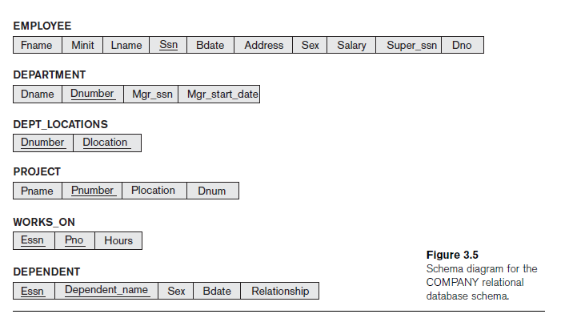
Site 1

Slide 61
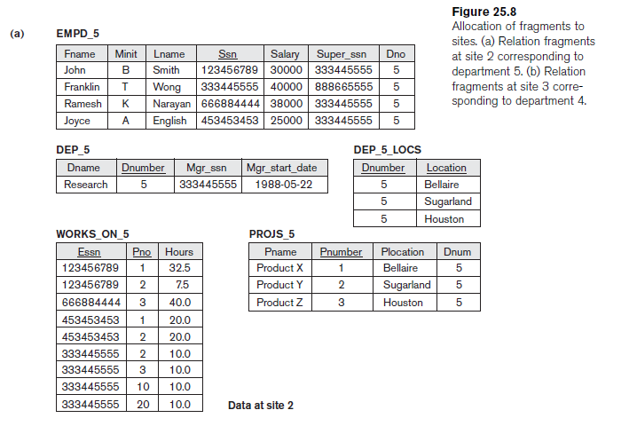
Site 2

Slide 62
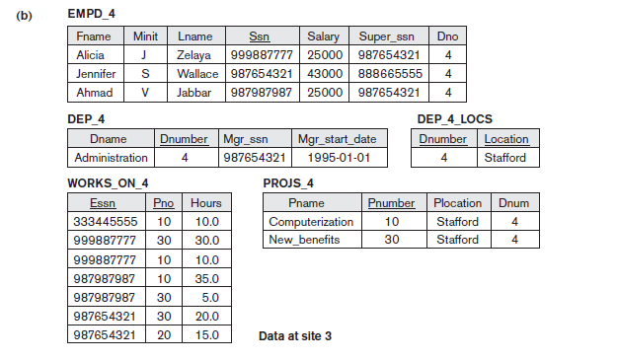
Site 3

Slide 63
EMPD5
attribute list: Fname, Minit, Lname, Ssn, Salary, Super_ssn, Dno
guard condition: Dno=5
DEP5
attribute list: * (all attributes Dname, Dnumber, Mgr_ssn, Mgr_start_date)
guard condition: Dnumber=5
DEP5_LOCS
attribute list: * (all attributes Dnumber, Location)
guard condition: Dnumber=5
PROJS5
attribute list: * (all attributes Pname, Pnumber, Plocation, Dnum)
guard condition: Dnum=5
WORKS_ON5
attribute list: * (all attributes Essn, Pno,Hours)
guard condition: Essn IN (πSsn (EMPD5)) OR Pno IN (πPnumber (PROJS5))

Slide 64
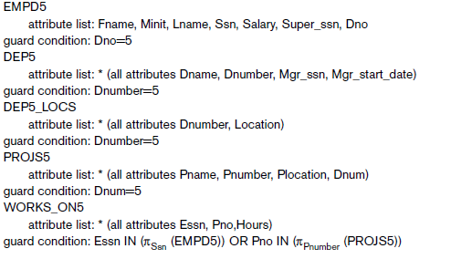
Query and Update Decomposition

Slide 65

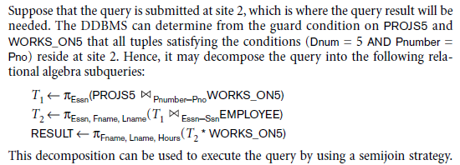
Query decompositon

Slide 66
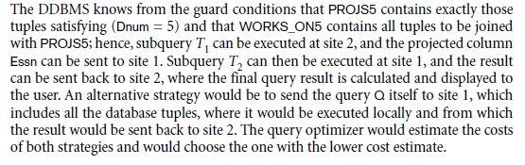

Slide 67
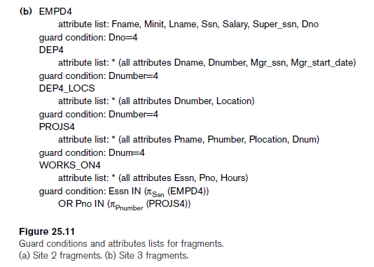
Decompose update query

Slide 68
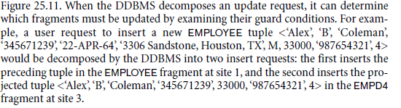
Decompose update query

